Slide 1
Disaster managers perspective of impact-based weather warnings in the Western Cape
19 March 2019

Slide 2
Early Warnings
What is an Early Warning:
Is timely and effective information, disseminated through identified institutions, that allow individuals, households, areas and communities exposed to a hazard to take action to avoid or reduce the risk and prepare for an effective response.
What is an Early Warning Systems
A system that allows for directing and forecasting impending extreme events to formulate warnings on the basis of scientific knowledge, monitoring and consideration of the factors that affect disaster severity and frequency.
Early Warning Systems should include the following processes:
An Understanding and mapping spatial extent of the hazard
Monitoring and forecasting impending events
Processing and disseminating understandable warnings
Undertaking appropriate and timely actions in response to these warnings
(Disaster Management Framework 2005)

Slide 3
Legislative Framework
Each organ of state is mandated by the Disaster Management Act 57 of 2002 (as amended by Disaster Management Act 16 of 2015), to develop early warning mechanisms for identified risks within its area of jurisdiction. Over and above, Key Performance Area 4: Response and Recovery of the Provincial Disaster Management Framework (PDMF) clearly sets out the objectives of early warnings and the role of the Provincial Disaster Management Centre (PDMC).
KPA 4: Objectives of Early Warnings
To establish mechanisms to ensure the development and implementation of standardised early warnings.
To implement a uniform approach to ensure the effective dissemination of early warnings to relevant role players and stakeholders.

Slide 4
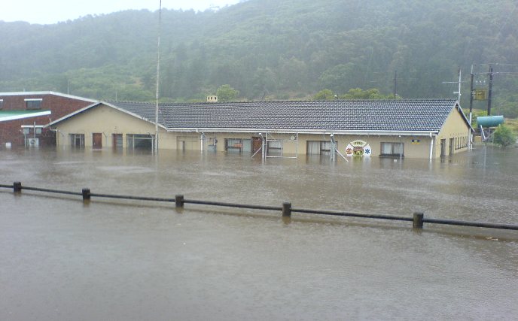
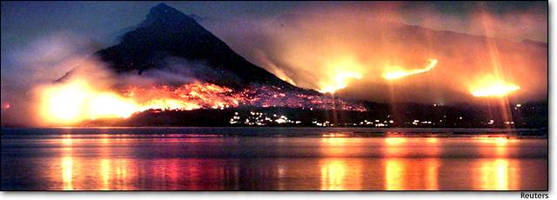
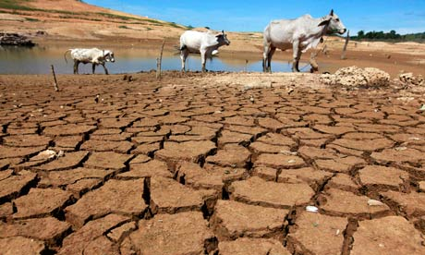
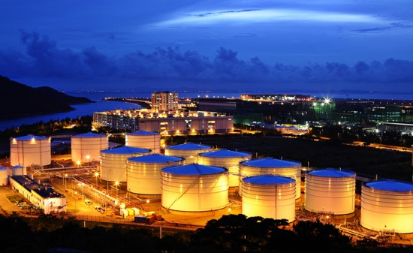
Main Risks in the Western Cape
WC most disaster prone province
Flooding
Many events over the years
Fires
Garden Route Fires
Drought
2009/10 + 2016/2018
Human and Animal Diseases
Avian Flu – 2011/12 + 2018
Industrial/HAZMAT Incidence
Major petro-chem installations
(Eden, West Coast, CoCT)

Slide 5
Early Warnings - Current StateWS
Current State:
What Weather will be….. USEFUL…….but…….

Slide 6
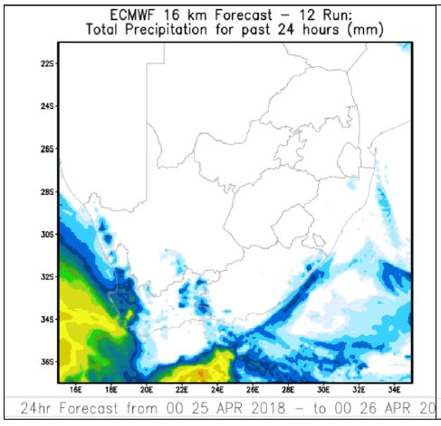
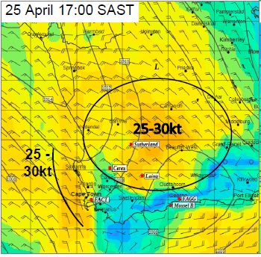
Paradigm Shift Required
Forecast needs to evolve from what weather will be, to what weather will do….
Weather thresholds
50mm in 24 hours
Physical & Social impacts
Roads flooded
Communities cut off
Power lines down

Slide 7
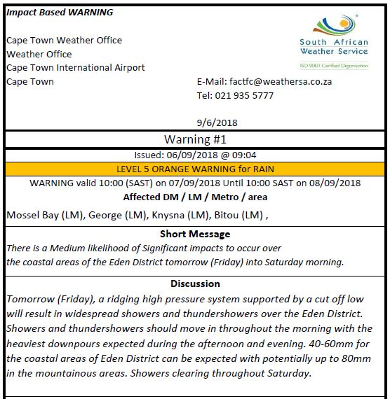
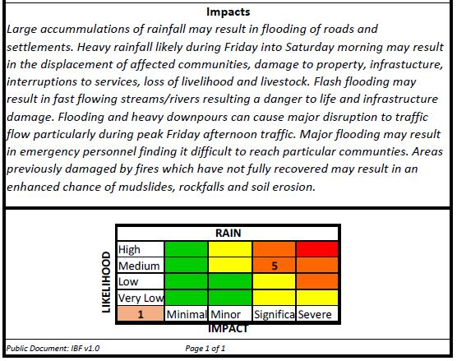
Early Warnings - Impact Based WS

Slide 8
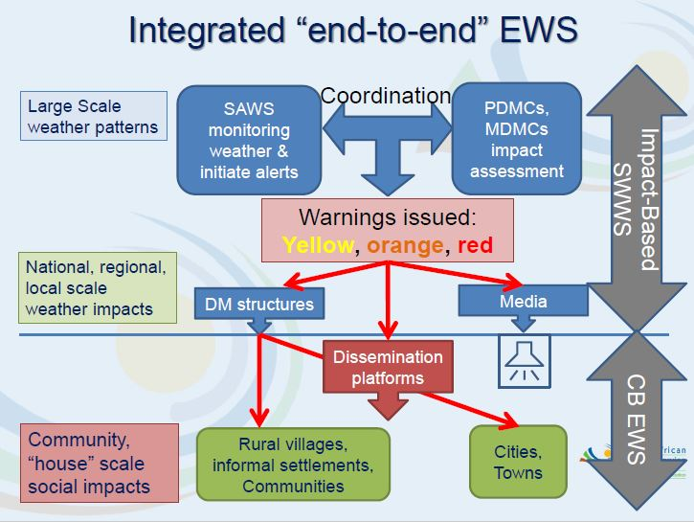
Information Flow within the IBF System

Slide 9
Process of Early Warnings – All Hazards
CURRENT GAP

Slide 10
Roll- Out of Web-based Decision Support Tool
CoCT
West Coast DM
WCDMC
Cape Winelands DM
Overberg DM
Central Karoo DM
Eden DM

Slide 11
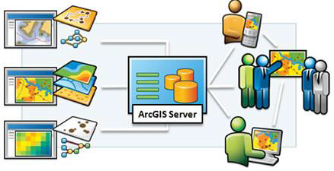
Flow of Data within Spatial Data Repository (SDR)
Spatial and Non-Spatial
data sets
Local
Disaster
Managers
And
Stakeholders
Data Repository
District Disaster
Managers
And
Stakeholders
Provincial
Disaster
Managers
And
Stakeholders

Slide 12
Early Warnings - Impact Based WS

Slide 13
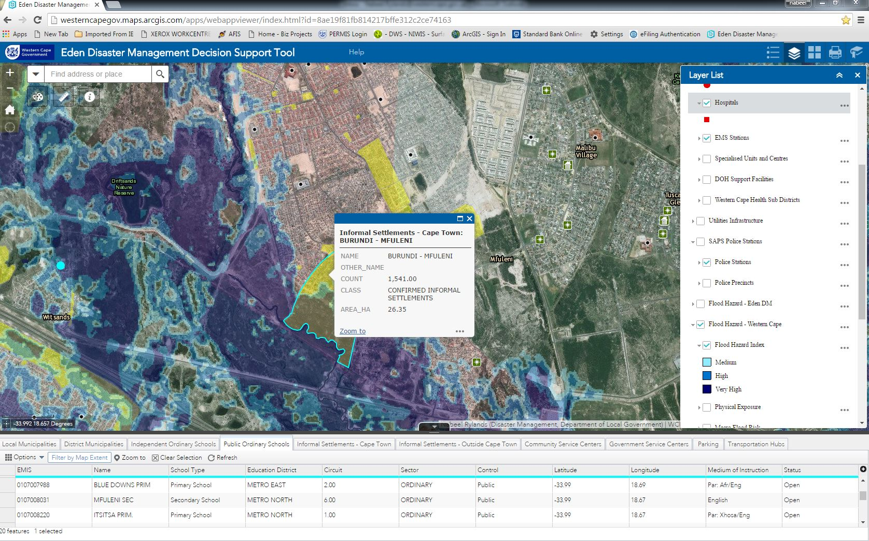
Web-based Decision Support Tool (DST)

Slide 14
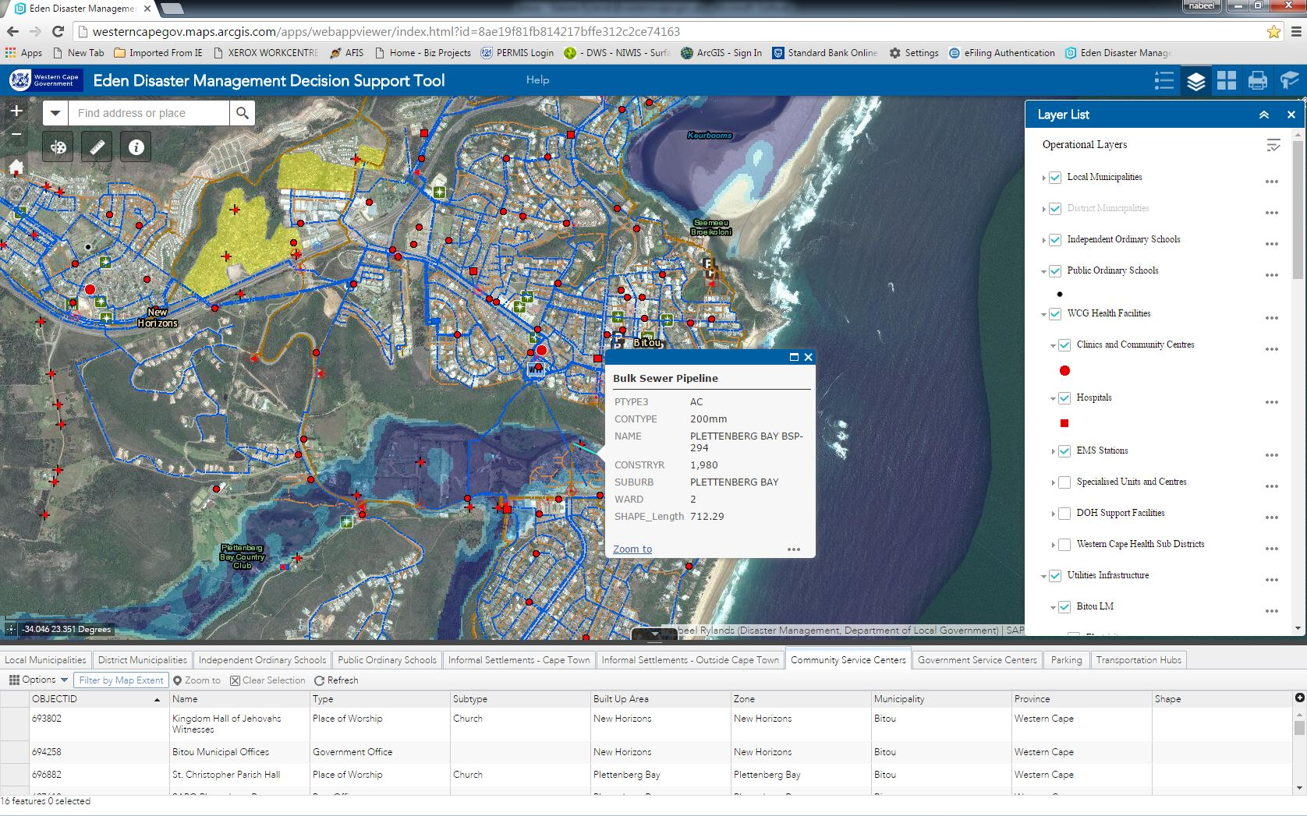
Web-based Decision Support Tool (DST)

Slide 15
All Hazard - Early Warning System

Slide 16
Benefits of the Impact Based Forecasting Approach
Was done in collaboration with Disaster Management officials from all 3 spheres of Government
Clear understanding of roles and responsibilities between DM and SAWS officials
Supports and guides the Decision Making process in DMC;
By understanding impact, we can better prepare our response strategy;
DM officials provide on the ground feedback to SAWS to confirm impacts and ground truthing;

Slide 17
THANK YOU

